Slide 1

welcome

Slide 2

Introduce
Tahmina
Assistant Teacher
Saildia Dakhil Madrasah
Kaligonj,Gazipur.

Slide 3
class:6
Sub:English 1st paper
Time:40m

Slide 4
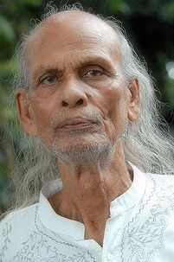
Look at the picture.
Do you know who is the man?

Slide 5
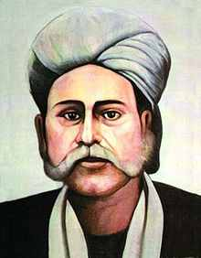
Do you know who is the man?
Hason Raja

Slide 6
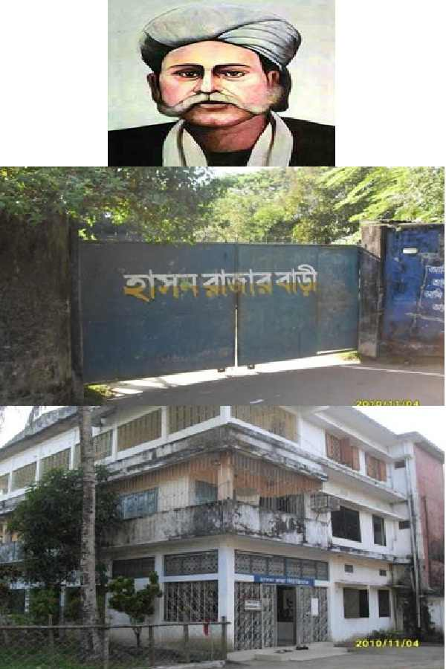
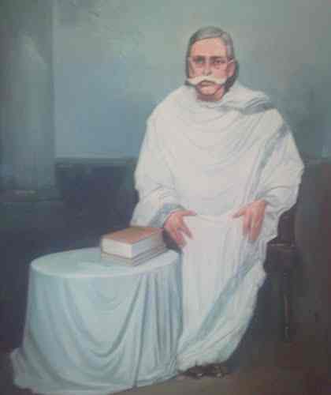

Slide 7
Topic name;
Lesson-21
Hason Raja;
The mystic bard of Bangladesh

Slide 8
Objectives of the lesson.
By the end of the lesson Student will be able to—
Ask and answer question
Read and understand text.
Write short composition.
Vocabulary.

Slide 9

Vocabulary
mystic
supernatural
meditation
Thought, contemplation
crazy
Wild, passionate, mad.
luxury
Lavishness, opulence

Slide 10
Read the text and answer the question;
Hason Raja was born in 1854 in a welthy landlord’s family in Sylhet
He did not receive much formal education
Hason Raja wrote a lot of songs, about a thousand in number.
His book called ‘ Hason Udash’ was a published in 1906.

Slide 11
Pair work
1.Who was Hason Raja?
2.When did Hason Raja lead a life of luxury?
3.What was his childhood like?

Slide 12
Evaluation
1.When was Hason Raja born?
Ans :Hason Raja was born in 1854.
2where did he come from?
Ans: He came from Sylhet
3.What was his childhood like?
Ans:Full of luxury ,comfort and pleasure.

Slide 13
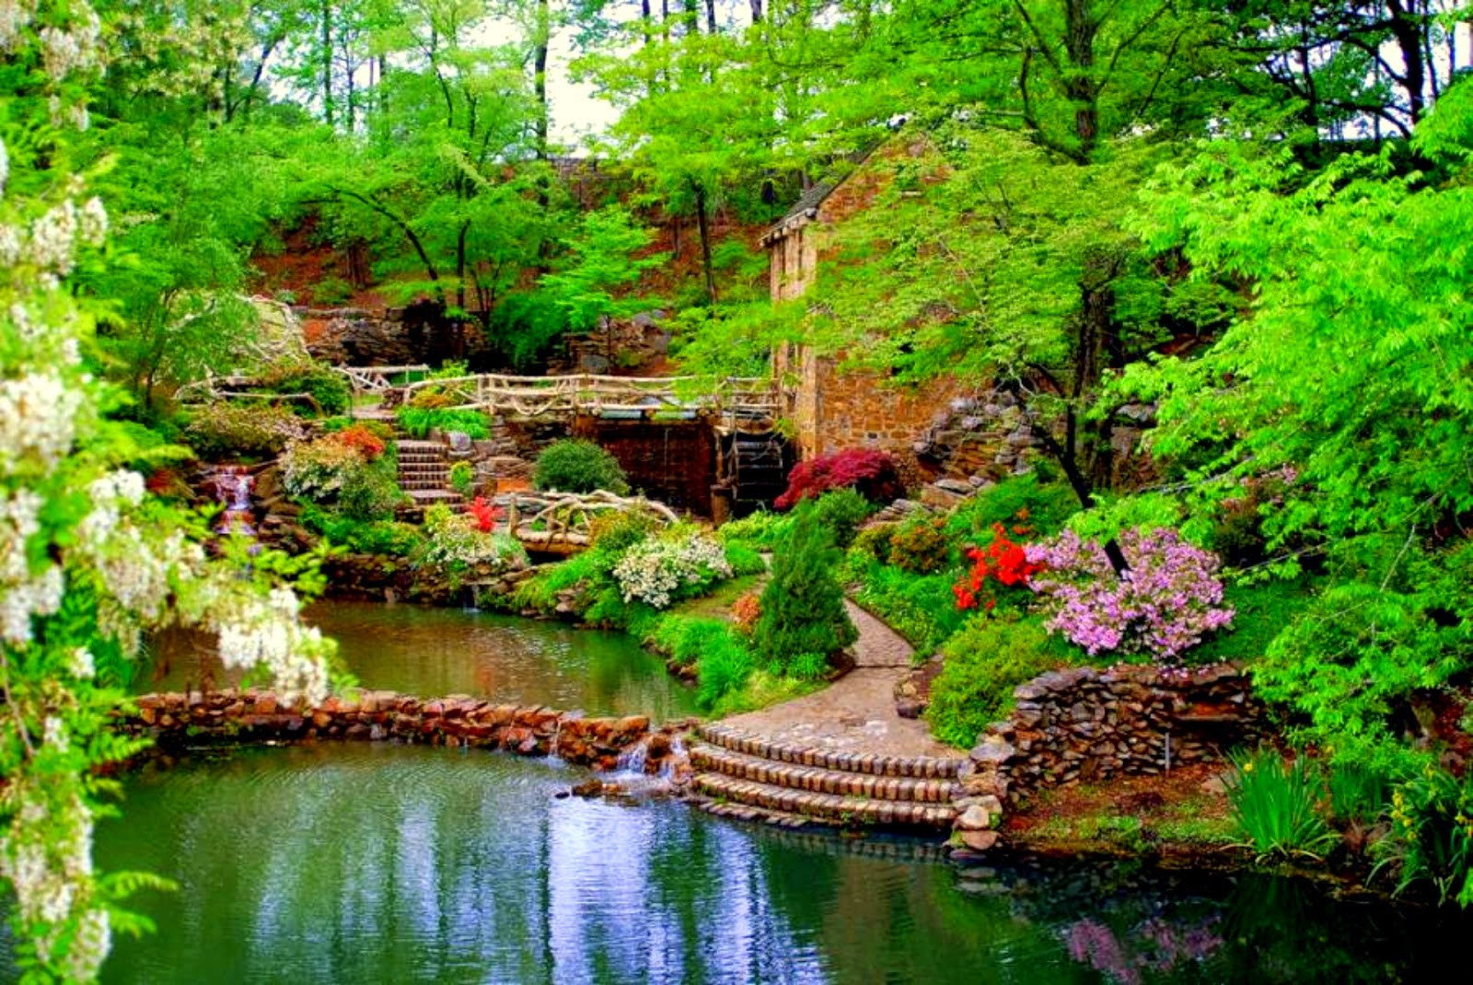
Home Work
Write a paragraph about “Hason Raja””

Slide 14
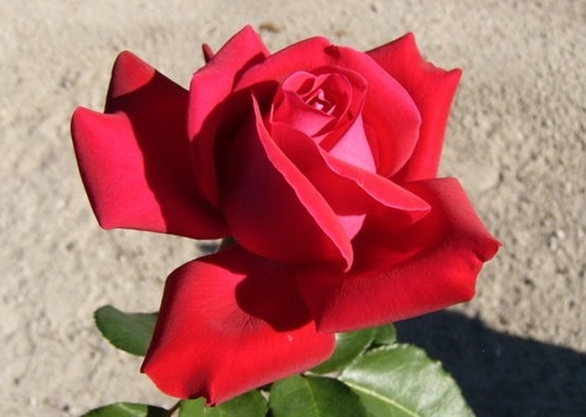
Thanks Everybody

